Slide 1

00 — Thumbnail
Java Course
SQL &
Databases
IIRINA FIODOROVA – JAVA DEVELOPER ANDREITEVA MARIA |
Notes:
The presentation title always need to be on the middle of the page and aligned to the left

Slide 2

02 — Aggregate Function
Aggregate Function
Notes:
The theme title always need to be on the middle of the page and aligned to the left

Slide 3
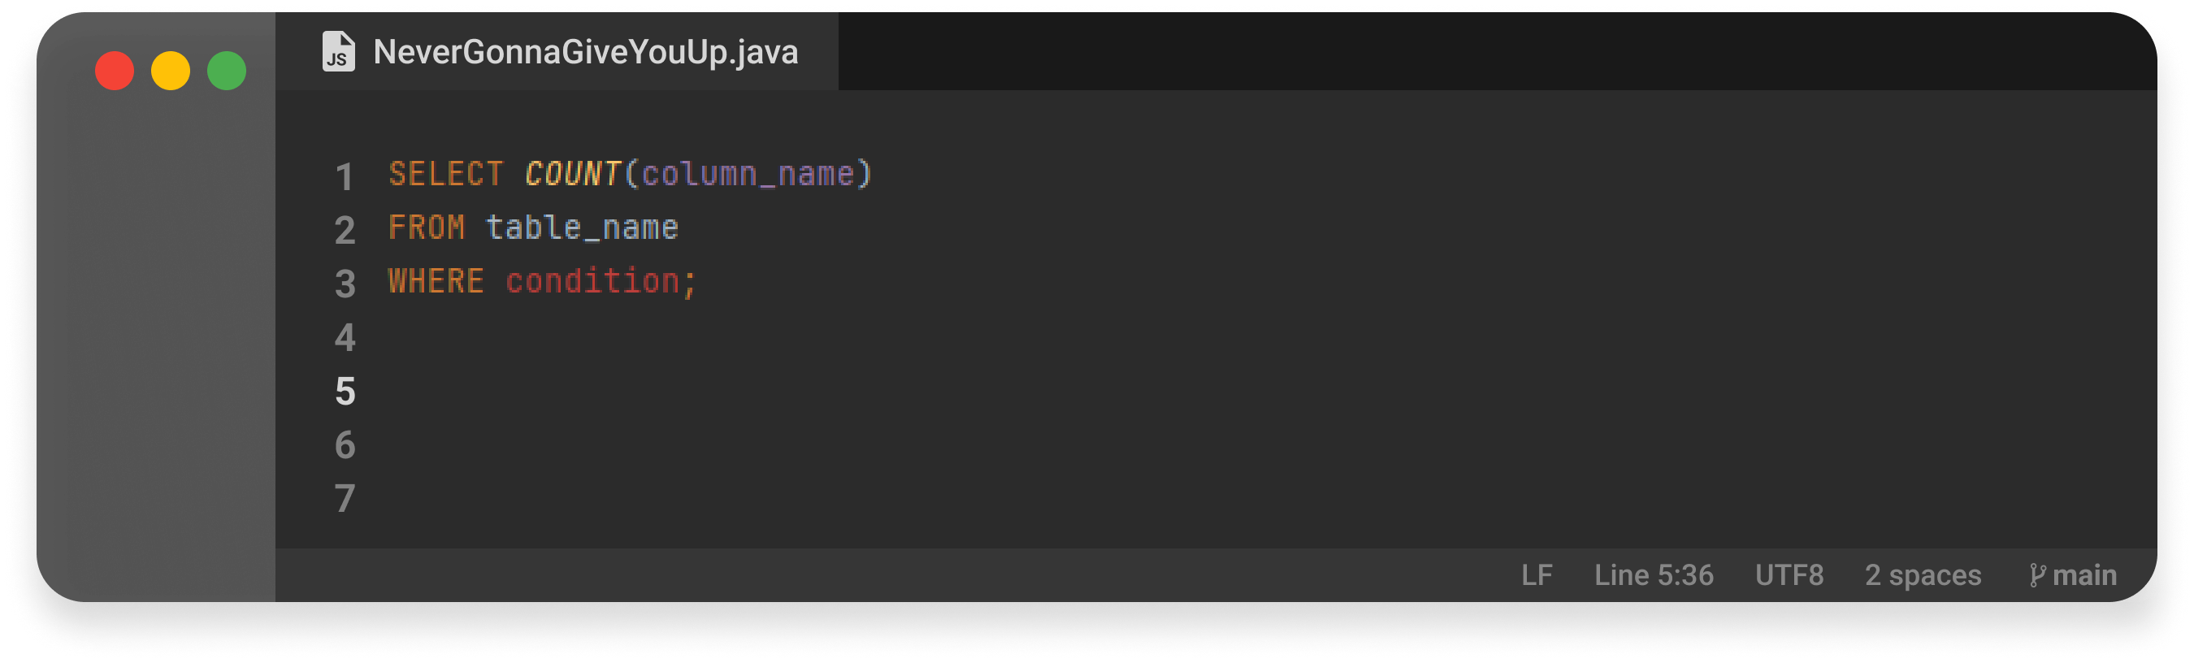
03 — Aggregate Function
COUNT
Returns the number of records returned by a select query.
Notes:
Slide for medium block of text. Text is always on the middle of the page, left aligned.

Slide 4
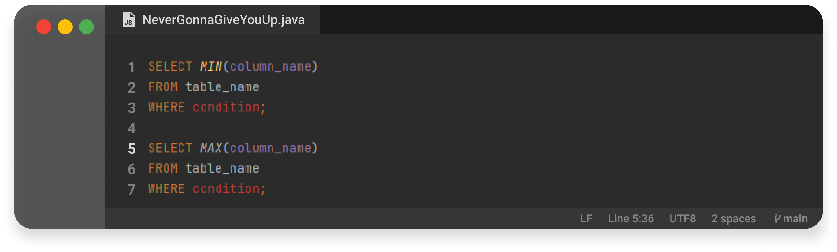
04 — Aggregate Function
MIN / MAX
Returns the minimum / maximum value in a set of values. ​
Notes:
Slide for medium block of text. Text is always on the middle of the page, left aligned.

Slide 5
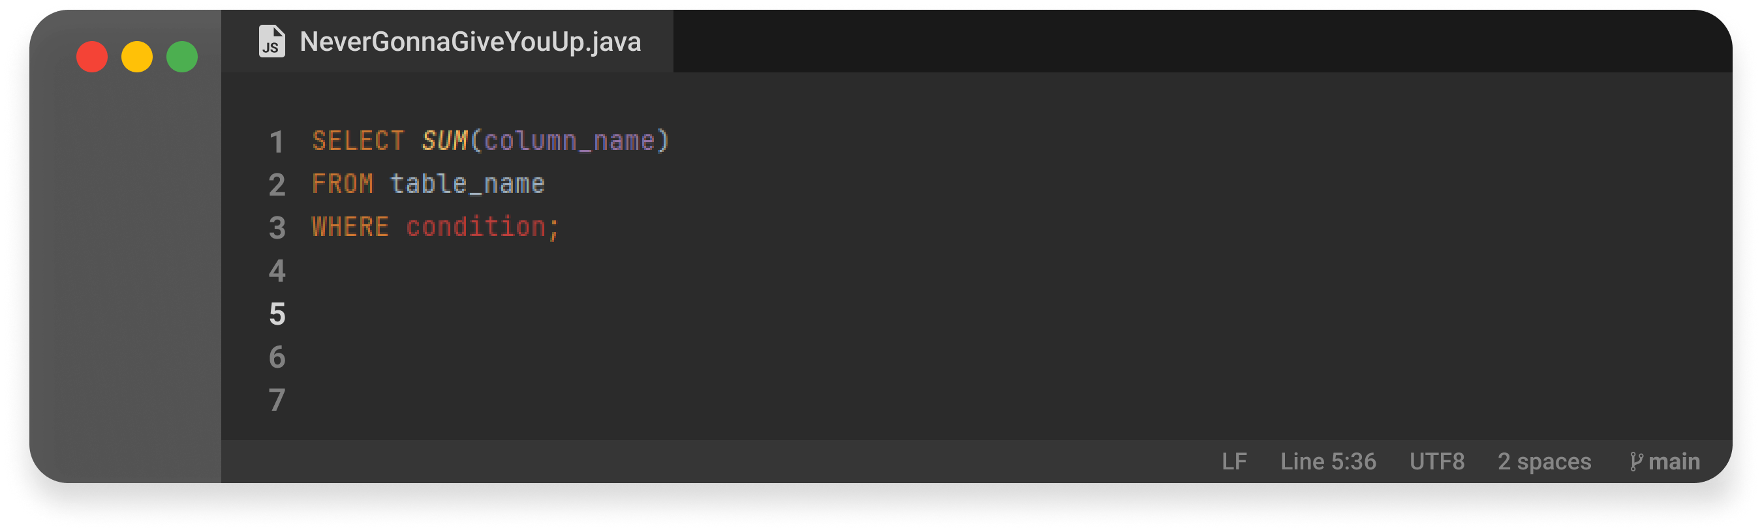
05 — Aggregate Function
SUM
Calculates the sum of a set of values.​
Notes:
Slide for medium block of text. Text is always on the middle of the page, left aligned.

Slide 6

06 — Aggregate Function
AVG
Returns the average value of an expression.​
Notes:
Slide for medium block of text. Text is always on the middle of the page, left aligned.

Slide 7
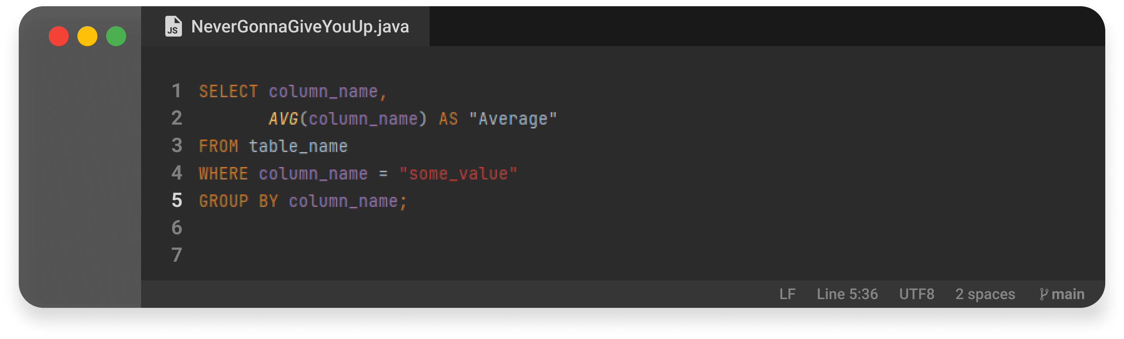
07 — Aggregate Function
GROUP BY
This statement is used in conjunction with aggregate functions to group the result-set by one or more columns. ​
Notes:
Slide for medium block of text. Text is always on the middle of the page, left aligned.

Slide 8
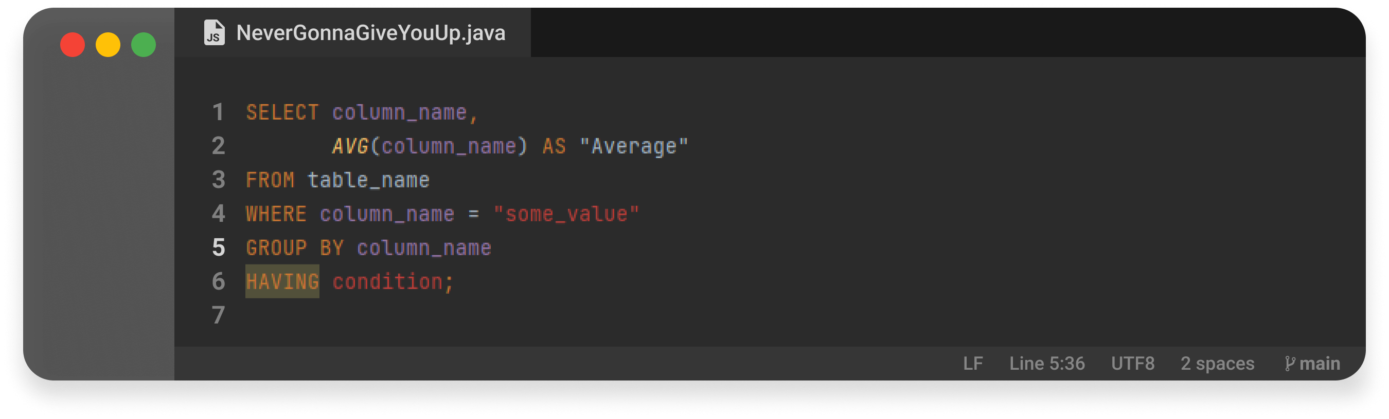
08 — Aggregate Function
HAVING
This statement enables you to specify conditions that filter which group results appear in the results.
Notes:
Slide for medium block of text. Text is always on the middle of the page, left aligned.

Slide 9
09 — Subqueries
Subqueries
Notes:
The theme title always need to be on the middle of the page and aligned to the left

Slide 10

10 — Subqueries
Subqueries
A sub-query is a query within a query. You can create subqueries within your SQL statements.​
These sub-queries can reside in the WHERE clause, the FROM clause, the SELECT clause or JOINs.​
Sub-queries must be enclosed with parenthesis.​
A sub-query must be put in the right hand of the comparison operator.​
A sub-query cannot contain an ORDER-BY clause.​
A query can contain more than one sub-query.
Notes:
Relational databases: These databases store data in tables that are related to each other through a common field or key. Examples of relational databases include MySQL, Oracle, and Microsoft SQL Server.
NoSQL databases: These databases are used to store unstructured data, such as social media posts, images, and videos. Examples of NoSQL databases include MongoDB, Cassandra, and Redis.
Object-oriented databases: These databases store data in objects that are related to each other through inheritance or composition. Examples of object-oriented databases include db4o and ObjectStore.
Hierarchical databases: These databases organize data in a tree-like structure, with parent and child nodes. Examples of hierarchical databases include IMS and RDM Server.
Network databases: These databases organize data in a network-like structure, with interconnected nodes. Examples of network databases include IDMS and Integrated Data Store.

Slide 11
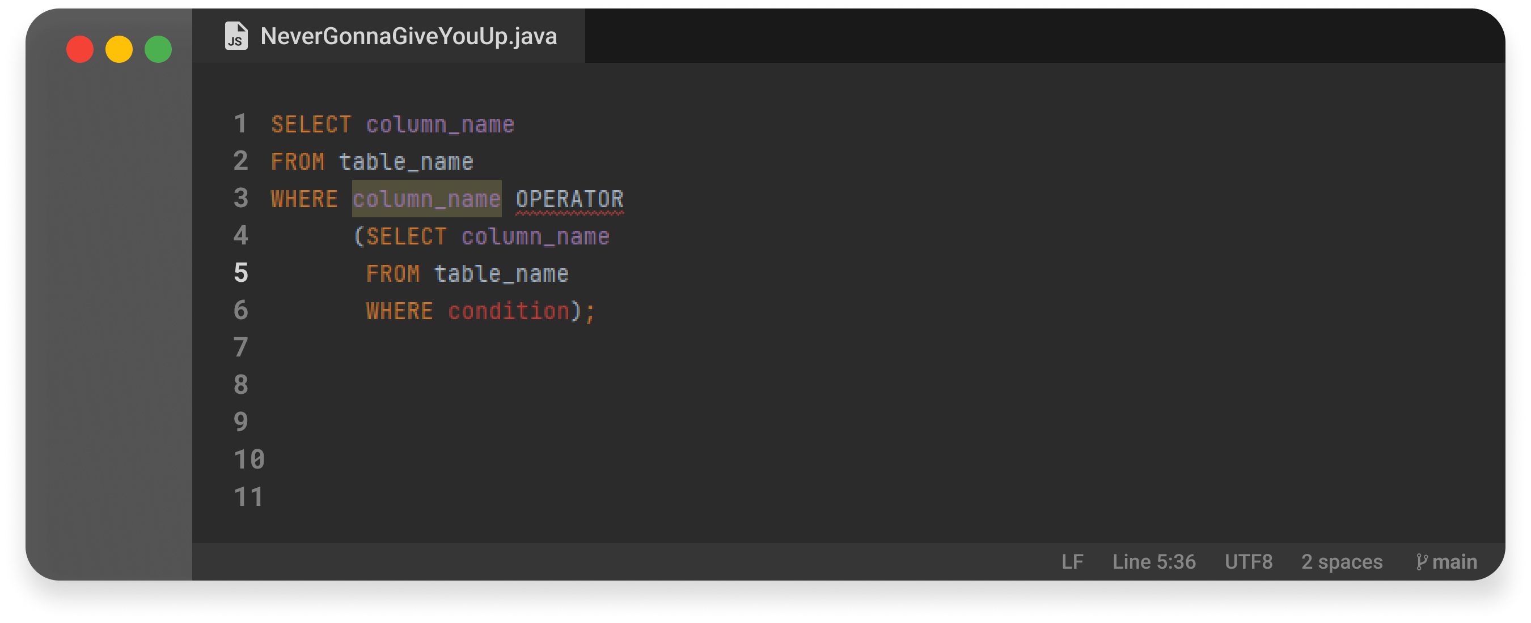
11 — Subqueries
Subqueries
Notes:
Relational databases: These databases store data in tables that are related to each other through a common field or key. Examples of relational databases include MySQL, Oracle, and Microsoft SQL Server.
NoSQL databases: These databases are used to store unstructured data, such as social media posts, images, and videos. Examples of NoSQL databases include MongoDB, Cassandra, and Redis.
Object-oriented databases: These databases store data in objects that are related to each other through inheritance or composition. Examples of object-oriented databases include db4o and ObjectStore.
Hierarchical databases: These databases organize data in a tree-like structure, with parent and child nodes. Examples of hierarchical databases include IMS and RDM Server.
Network databases: These databases organize data in a network-like structure, with interconnected nodes. Examples of network databases include IDMS and Integrated Data Store.

Slide 12
12 — Join & Union
Join & Union
Notes:
The theme title always need to be on the middle of the page and aligned to the left

Slide 13
13 — Join & Union
JOIN
A JOIN clause is used to combine rows from two or more tables, based on a related column between them.
Inner join
Left join
Right join
Full join
Cross join
Natural join
Notes:
Slide for a big block text.

Slide 14
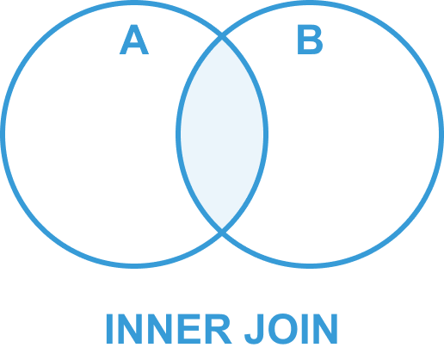
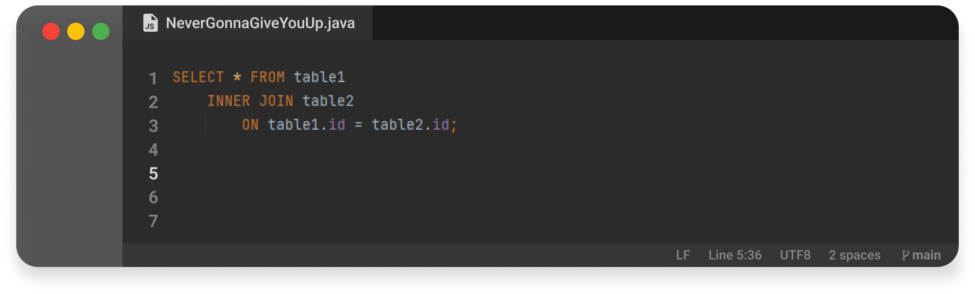
14 — Join & Union
Inner join
Returns all rows when there is at least one match in BOTH tables.​
Notes:
Slide for big block text with a subtitle and WHITE BACKGROUND IMAGE.

Slide 15
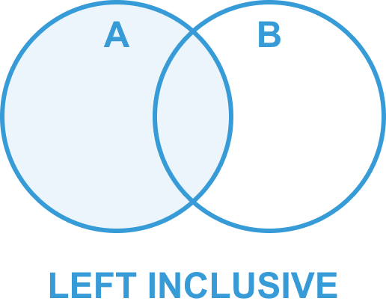

15 — Join & Union
Left join
Returns all rows from the left table (table1), with the matching rows in the right table (table2). ​
The result is NULL in the right side when there is no match.
Notes:
Slide for big block text with a subtitle and WHITE BACKGROUND IMAGE.

Slide 16
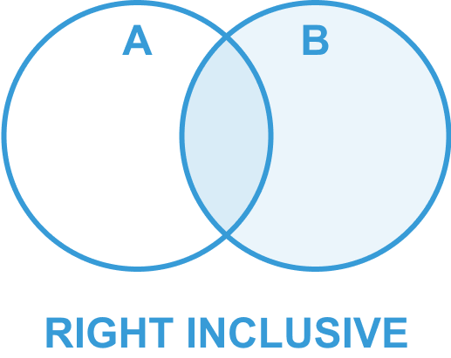

16 — Join & Union
Right join
Returns all rows from the right table (table2), with the matching rows in the right table (table1). ​
The result is NULL in the left side when there is no match.
Notes:
Slide for big block text with a subtitle and WHITE BACKGROUND IMAGE.

Slide 17
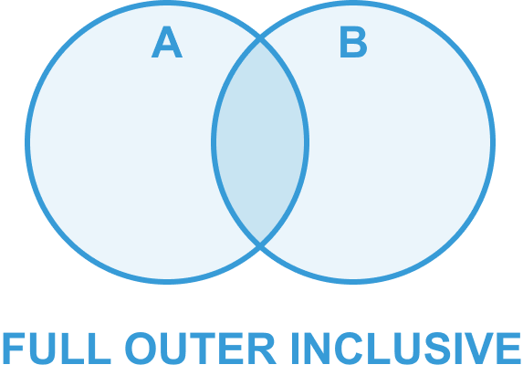
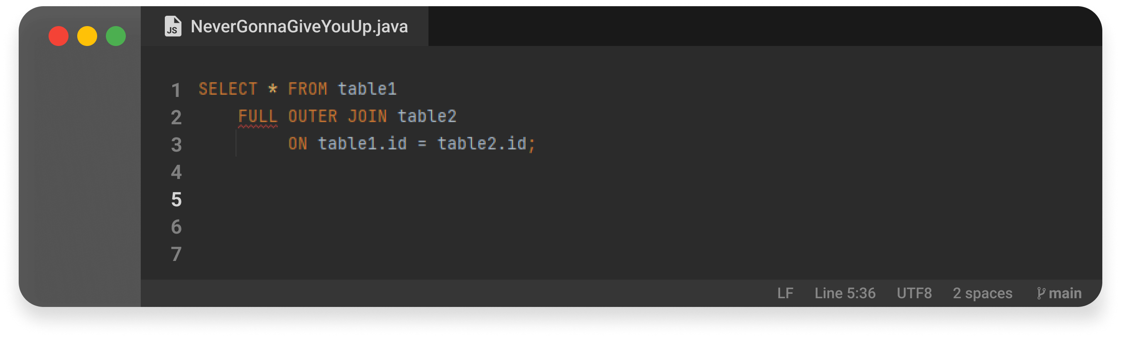
17 — Join & Union
Full join
Returns all rows from the left table (table1) and from the right table (table2).​
Notes:
Slide for big block text with a subtitle and WHITE BACKGROUND IMAGE.

Slide 18
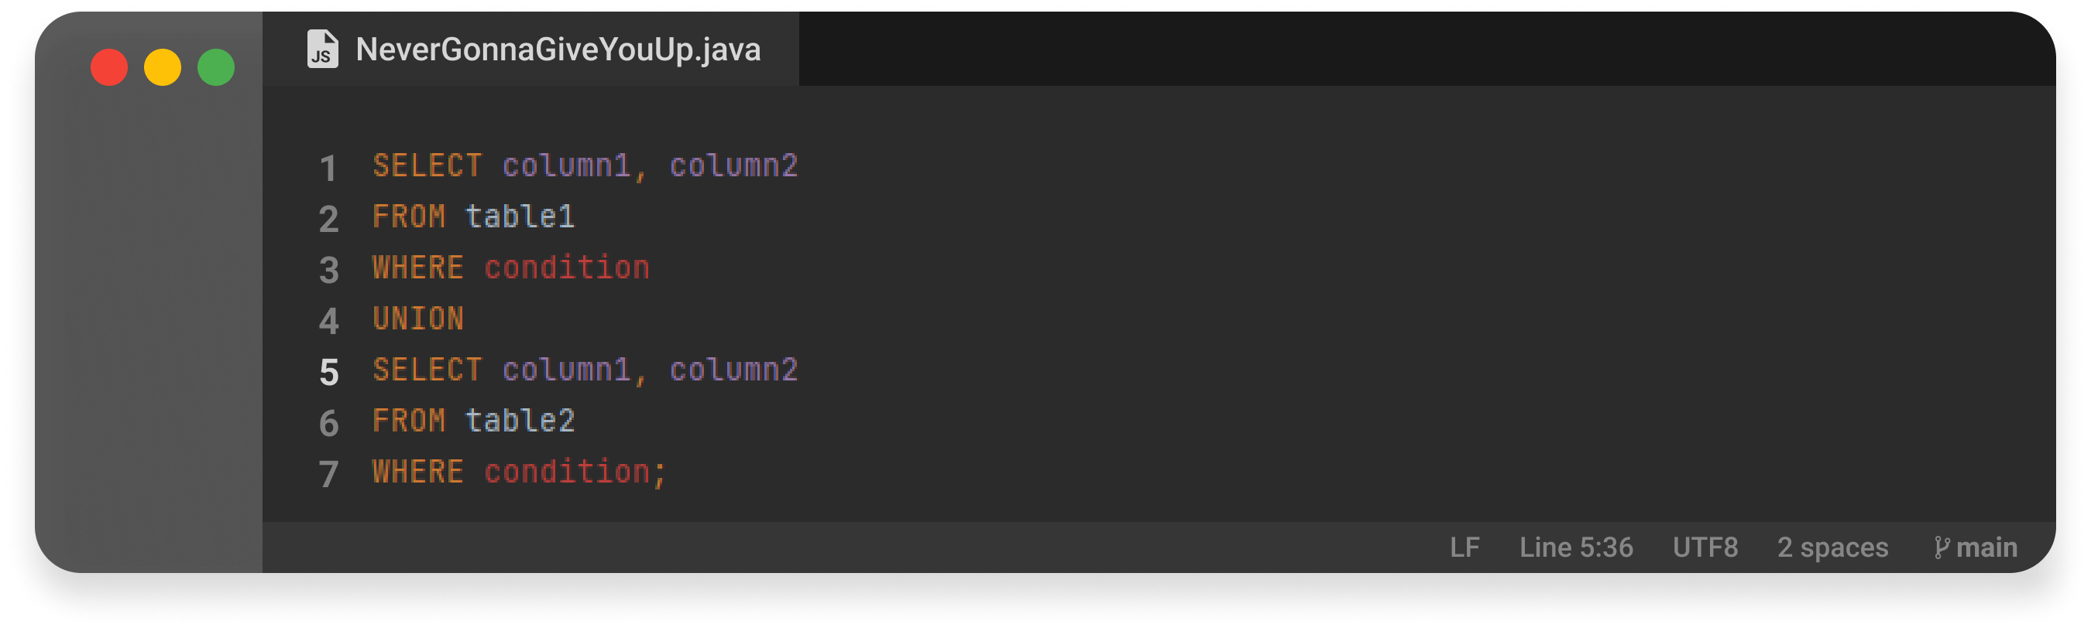
18 — Join & Union
Union
This operator combines the result of two or more SELECT statements.
Notes:
Both UNION and FULL JOIN are used in SQL to combine data from two or more tables, but they operate in different ways.
UNION is used to combine the results of two or more SELECT statements into a single result set. The SELECT statements must have the same number of columns, and the data types of the corresponding columns must be compatible. The UNION operator removes duplicates from the result set, so each row in the result set is unique.

Slide 19
19 — Transaction Control Language (TCL)
Transaction Control Language (TCL)
Notes:
The theme title always need to be on the middle of the page and aligned to the left

Slide 20
20 — Transaction Control Language (TCL)
Transaction
A SQL transaction is a grouping of one or more SQL statements that interact with a database. A transaction in its entirety can commit to a database as a single logical unit or rollback (become undone) as a single logical unit. In SQL, transactions are essential for maintaining database integrity. They are used to preserve integrity when multiple related operations are executed concurrently, or when multiple users interact with a database concurrently.
Transactional control commands are only used with the DML commands INSERT, UPDATE and DELETE only. They cannot be used while creating tables or dropping them because these operations are automatically committed in the database.
Notes:
Slide for big block text with a subtitle and WHITE BACKGROUND IMAGE.

Slide 21
21 — Transaction Control Language (TCL)
ACID
ATOMICITY
CONSISTENCY
ISOLATION
DURABILITY
Ensures that all operations within the work unit are completed successfully; otherwise, the transaction is aborted at the point of failure and previous operations are rolled back to their former state.
Ensures that the database properly changes states upon a successfully committed transaction
Enables transactions to operate independently of and transparent to each other.
Ensures that the result or effect of a committed transaction persists in case of a system failure.

Slide 22
22 — Transaction Control Language (TCL)
Transaction Control Language (TCL)
BEGIN TRANSACTION
COMMIT
ROLLBACK
Ensures that all operations within the work unit are completed successfully; otherwise, the transaction is aborted at the point of failure and previous operations are rolled back to their former state.
Ensures that the database properly changes states upon a successfully committed transaction
Enables transactions to operate independently of and transparent to each other.

Slide 23
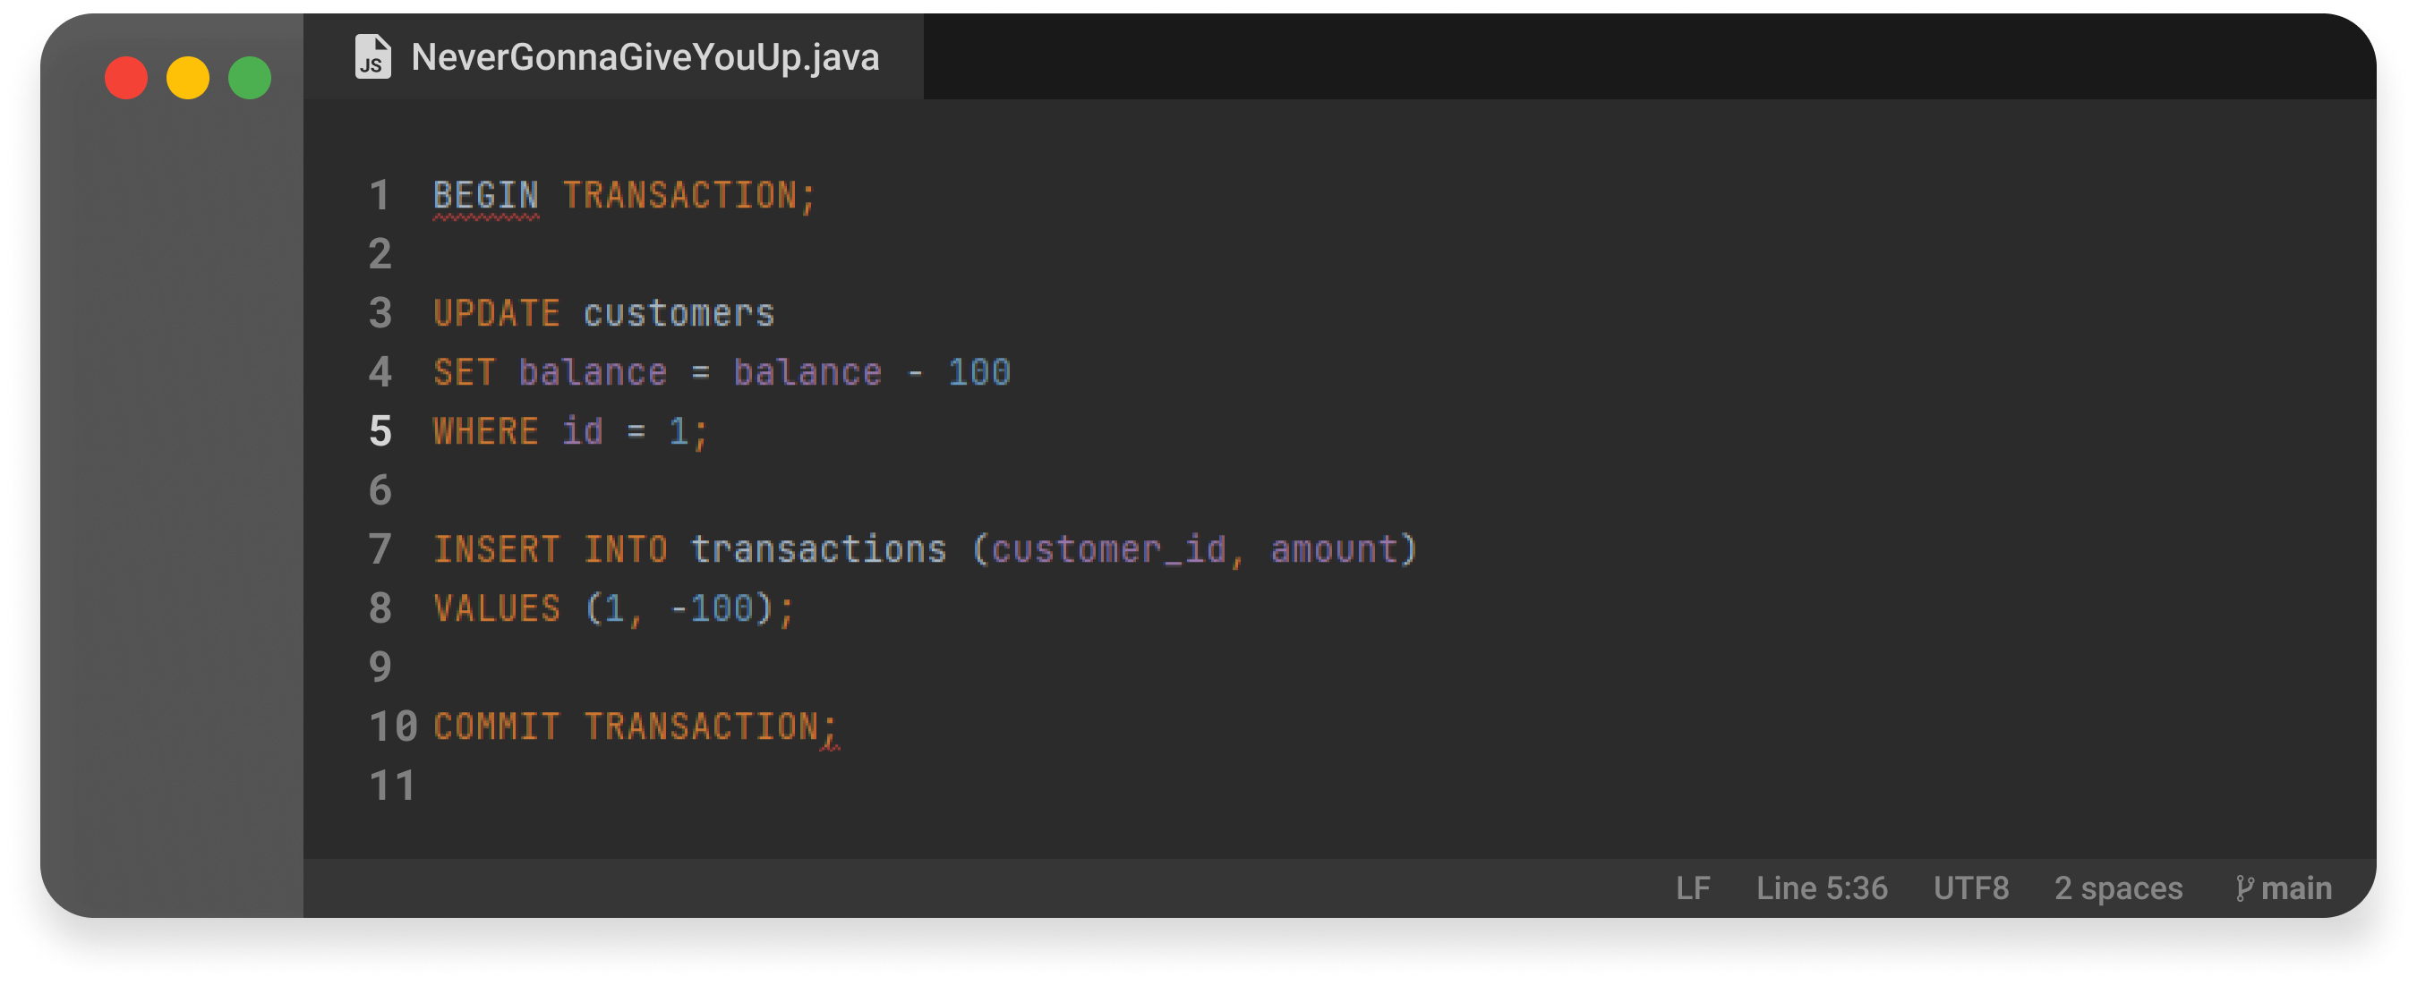
23 — Transaction Control Language (TCL)
Transaction
Notes:
Relational databases: These databases store data in tables that are related to each other through a common field or key. Examples of relational databases include MySQL, Oracle, and Microsoft SQL Server.
NoSQL databases: These databases are used to store unstructured data, such as social media posts, images, and videos. Examples of NoSQL databases include MongoDB, Cassandra, and Redis.
Object-oriented databases: These databases store data in objects that are related to each other through inheritance or composition. Examples of object-oriented databases include db4o and ObjectStore.
Hierarchical databases: These databases organize data in a tree-like structure, with parent and child nodes. Examples of hierarchical databases include IMS and RDM Server.
Network databases: These databases organize data in a network-like structure, with interconnected nodes. Examples of network databases include IDMS and Integrated Data Store.

Slide 24
24 — Index
Index
Notes:
The theme title always need to be on the middle of the page and aligned to the left

Slide 25
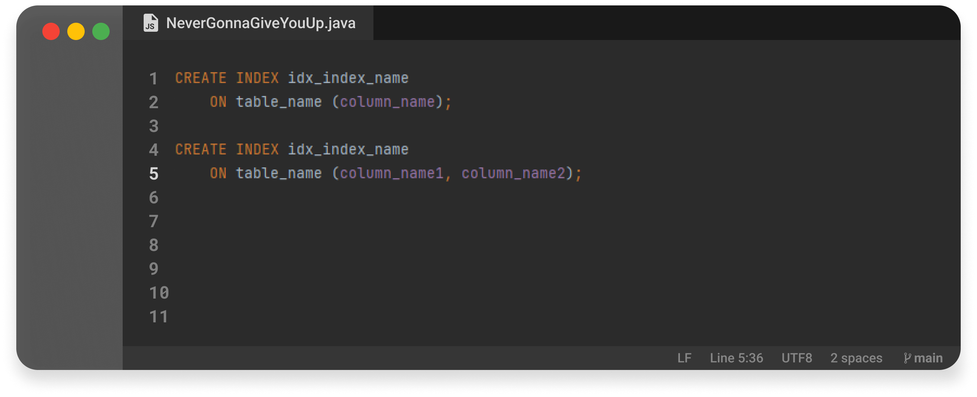
25— Index
Index
INDEX allows the database application to find data fast; without reading the whole table.​
Notes:
Slide for big block text with a subtitle and WHITE BACKGROUND IMAGE.

Slide 26
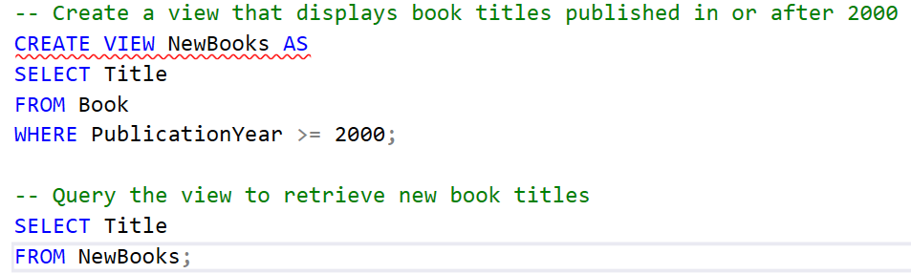
25— Index
View
A view in a database is a virtual table derived from one or more base tables. It's a saved query that provides a way to simplify and abstract complex data, offering a customized, simplified, and secure presentation of data.​
Notes:
Slide for big block text with a subtitle and WHITE BACKGROUND IMAGE.

Slide 27
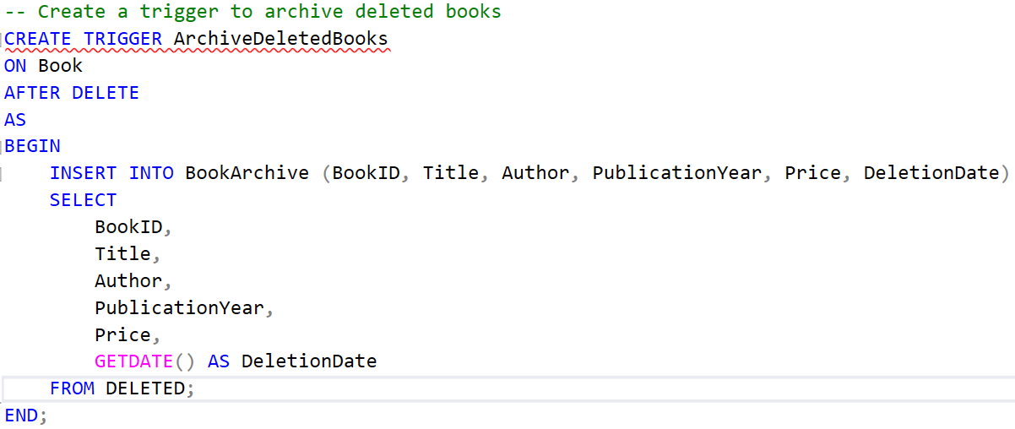
25— Index
Trigger
A trigger in a database is a set of instructions that automatically execute in response to a specific event, such as data modification (INSERT, UPDATE, DELETE). Triggers are used to enforce data integrity, implement business rules, or log changes.
Notes:
Slide for big block text with a subtitle and WHITE BACKGROUND IMAGE.

Slide 28
26 — Q&A
Q&A
Notes:
Slide for Q&A.

Slide 29
27 — Never Gonna Give You UP!
Thank YOU <3
Notes:
“Thank you” slide

